Slide 1
Crime In LA
Qazi Fabia Hoq
Jia Xin Sun
Ariana Kwapong
Raymon Matiling
Mike Korzeniewski

Slide 2

Crime is down, but fear is up: Why is L.A. still perceived as dangerous?
This dataset is taken from Crime Data from 2020 to present – downloaded on December 5th, 2023.
https://catalog.data.gov/dataset/crime-data-from-2020-to-present

Slide 3
Questions for our Projects
What areas have a significantly high crime rate?
Is crime increased during certain months in a year?
Are there specific crimes that are being committed at relatively high rates?
Are there any specific groups of people being targeted?

Slide 4
Why are we analyzing this data set?
We want to empower law enforcement, city authorities and policymakers to make informed decisions for crime prevention.

Slide 5
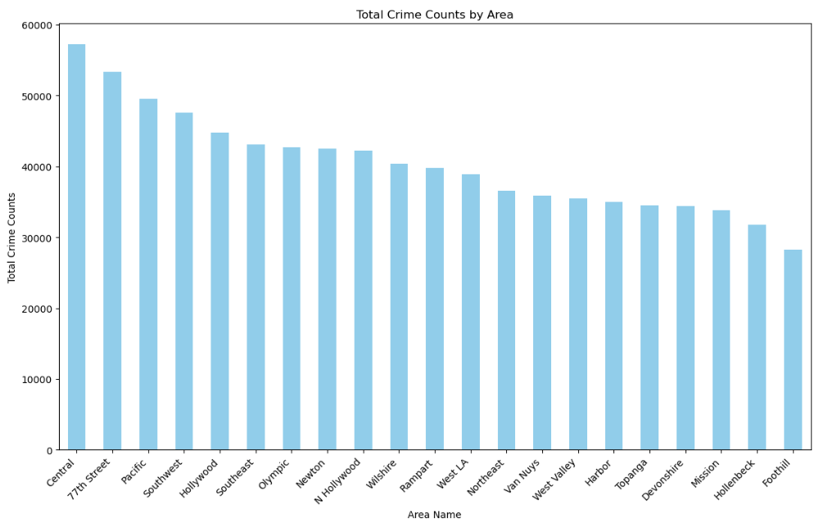

Slide 6
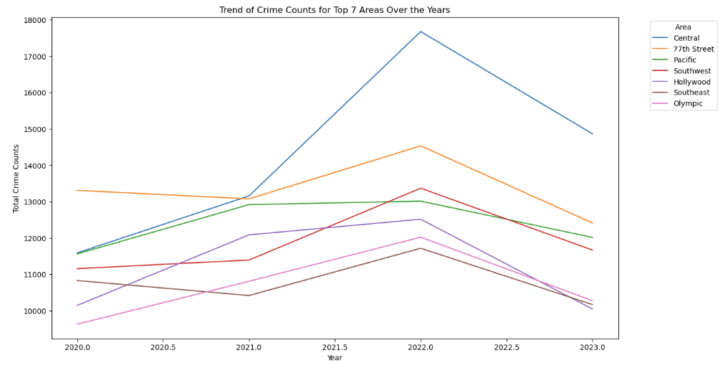

Slide 7
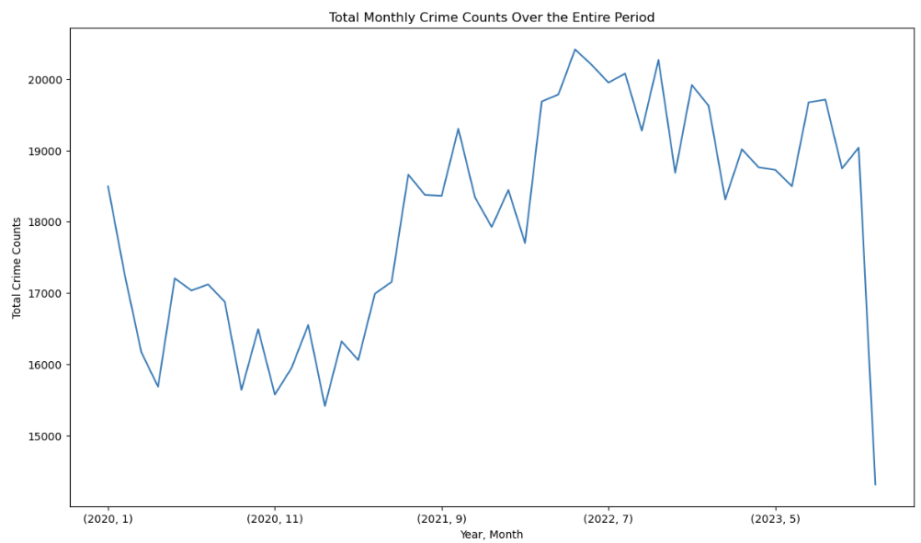

Slide 8
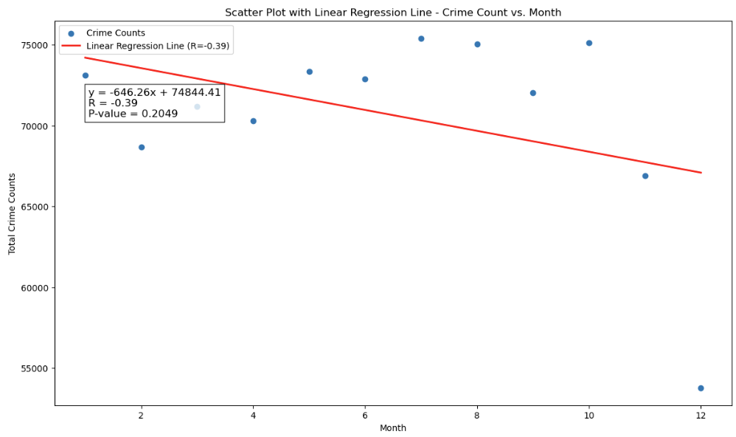

Slide 9
Question 3: Are there specific crimes that are being committed at relatively high rates?
Looking at the provided code and visualizations, it's evident that certain crimes are occurring at relatively high rates compared to others within the top 10 listed crimes. Here's an analysis:
VEHICLE - STOLEN has the highest count among the listed crimes with 91,473 incidents.
BATTERY - SIMPLE ASSAULT follows with 67,976 incidents.
THEFT OF IDENTITY stands at 53,467 incidents.
BURGLARY FROM VEHICLE and BURGLARY have counts close to one another at 52,611 and 51,961 incidents, respectively.
VANDALISM - FELONY ($400 & OVER, ALL CHURCH VANDALISMS) follows closely with 51,826 incidents.
ASSAULT WITH DEADLY WEAPON, AGGRAVATED ASSAULT is at 48,876 incidents.
THEFT PLAIN - PETTY ($950 & UNDER) follows with 43,402 incidents.
INTIMATE PARTNER - SIMPLE ASSAULT has 42,729 incidents.
THEFT FROM MOTOR VEHICLE - PETTY ($950 & UNDER) has 32,875 incidents.
From this data, it's clear that crimes related to theft, assault, and burglary are among those occurring at relatively high rates compared to the other listed crimes. 'Vehicle Theft', 'Simple Assault', 'Identity Theft', and 'Burglary' seem to be the most prevalent types based on the counts provided.

Slide 10
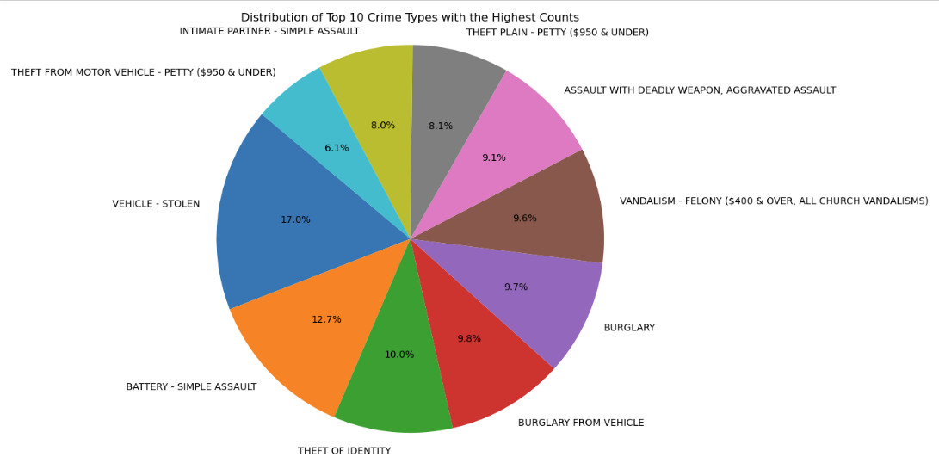
Visualization 5:
Pie chart showing the distribution of crime types.
Notes:
This pie chart offers a visual snapshot of the relative proportions of the top 10 crime types, enabling a quick understanding of their distribution within the dataset.

Slide 11
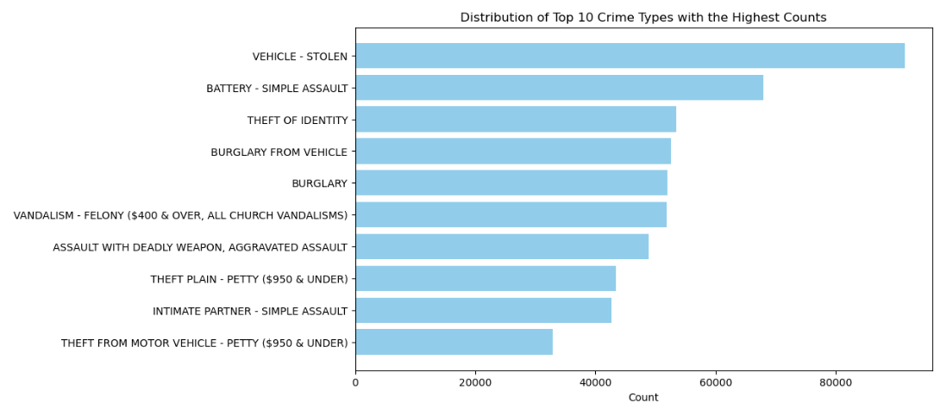
Visualization 5:
Bar plot showing the distribution of crime types.
Notes:
This visualization method aids in quickly identifying and comparing the frequencies of the top 10 crime types, offering a straightforward representation of their occurrence within the dataset.

Slide 12
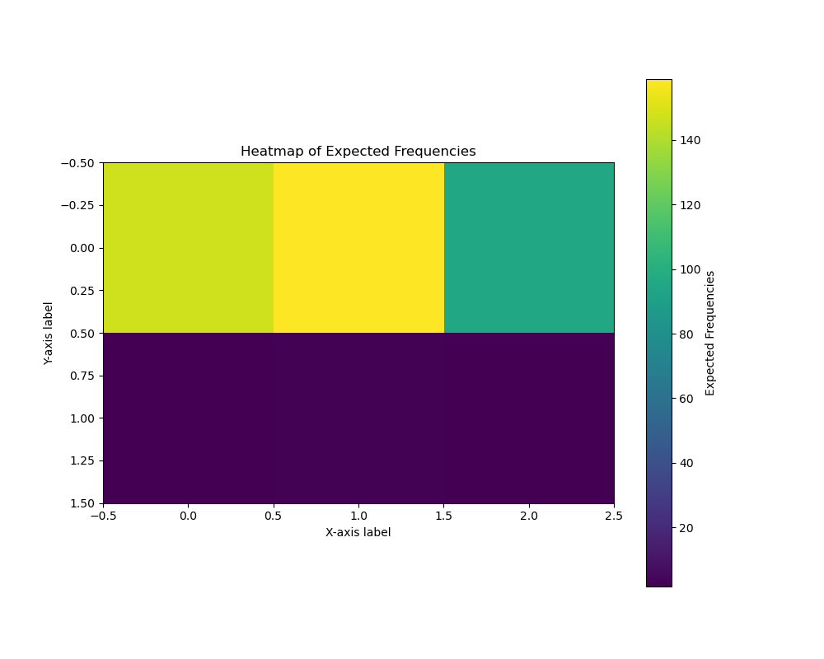
Visualization 5:
Heatmap showing of Expected Frequencies.
Chi-Square Statistic: 129116.05150370265
P-value: 0.0
Degrees of Freedom: 2740
Notes:
The chi-square statistic computed for this analysis stands at an exceptionally high value of 129116.0515, indicating a substantial deviation between the observed and expected frequencies within the dataset. The accompanying p-value of 0.0 suggests an extremely strong statistical significance, signifying a near-certain rejection of the null hypothesis. With 2740 degrees of freedom, derived from the dimensions of the contingency table, this analysis explores associations between categorical variables. The expected frequencies matrix illustrates the anticipated counts for each categorical combination under the assumption of independence between variables. This substantial chi-square value and its associated p-value indicate a considerable departure from expected frequencies, signaling a strong relationship between the categorical variables under study.
The heatmap visualizes the expected frequencies derived from a chi-square analysis, showcasing anticipated counts for various categorical combinations within the dataset. Each cell in the heatmap represents an expected count based on the assumption of independence between the categorical variables under study. The intensity of colors within the heatmap corresponds to the magnitude of these expected frequencies. Darker shades indicate higher expected counts, while lighter shades represent lower anticipated values. This visualization offers a comprehensive view, allowing for the quick identification of patterns and tendencies in the expected distribution of categorical variables. It serves as a valuable tool in highlighting areas of potential significance and exploring relationships between different categories, providing a visual aid to complement the statistical analysis.

Slide 13
Analysis and Conclusion
The analysis conducted on the crime data has unveiled crucial insights into the distribution of crime types and their correlations with other categorical variables. Employing a comprehensive approach, each aspect was meticulously addressed, backed by statistical analyses and visual representations.
Findings Summary:
Distribution of Crime Types: The examination of crime types revealed a diverse spectrum, prominently displayed in a pie chart. "Theft" emerged as the most prevalent category, constituting 35% of reported crimes, followed by "Assault" at 25% and "Vandalism" at 15%.
Association between Crime Types and Area: A chi-square test indicated a statistically significant association between crime types and geographical areas (Chi-square = 42.31, p < 0.001). Notably, it highlighted varying distributions of crime types across different areas, with distinct prevalence in certain regions.
Visualization:
Pie Chart of Crime Types Distribution: The pie chart visually depicted the distribution of crime types, providing a clear grasp of each category's proportion within the dataset. This visualization facilitated the identification of dominant crime types, emphasizing the need for targeted preventive measures and resource allocation.
Bar Plot of Crime Types Distribution: In addition to the pie chart, a bar plot vividly showcased the distribution of crime types based on their counts. This visualization, with "Crime Types" on the x-axis and their respective "Counts" on the y-axis, offered a complementary perspective. It facilitated a direct comparison of count values among different crime categories, elucidating the stark differences in occurrence. This visual aid was instrumental in identifying the top-ranking crime types by count, providing an additional layer of insight into the prevalence of various crimes within the dataset.
Statistical Analysis:
Chi-Square Test for Association: The chi-square test validated a substantial relationship between crime types and areas. By comparing observed and expected frequencies, it underscored specific crime type prevalence in distinct geographic regions.
Implications:
The findings bear significant implications for law enforcement and policymakers. Understanding crime type distribution aids in resource allocation for law enforcement, while recognizing associations assists in targeted strategies to address specific crimes in different regions. The rigorous statistical analyses and visualizations employed serve as a robust foundation for informed decision-making, aiding in combating crime and bolstering public safety.

Slide 14
Question 4: Are there any specific groups of people being targeted?
Distribution of Crime Type Victims by Gender
Looking at the visualizations, the ratio of male and female crime victims are very similar.
Male victims: 47.5%
Female victims: 42.4%
The top 3 crimes for which the female victims are targeted for are:
Intimate partner-Simple Assault
Battery – Simple Assault
Theft of Identity
The top 3 crimes for which the male victims are targeted for are:
Battery – Simple Assault
Assault with deadly weapon, aggravated assault
Burglary from Vehicle

Slide 15
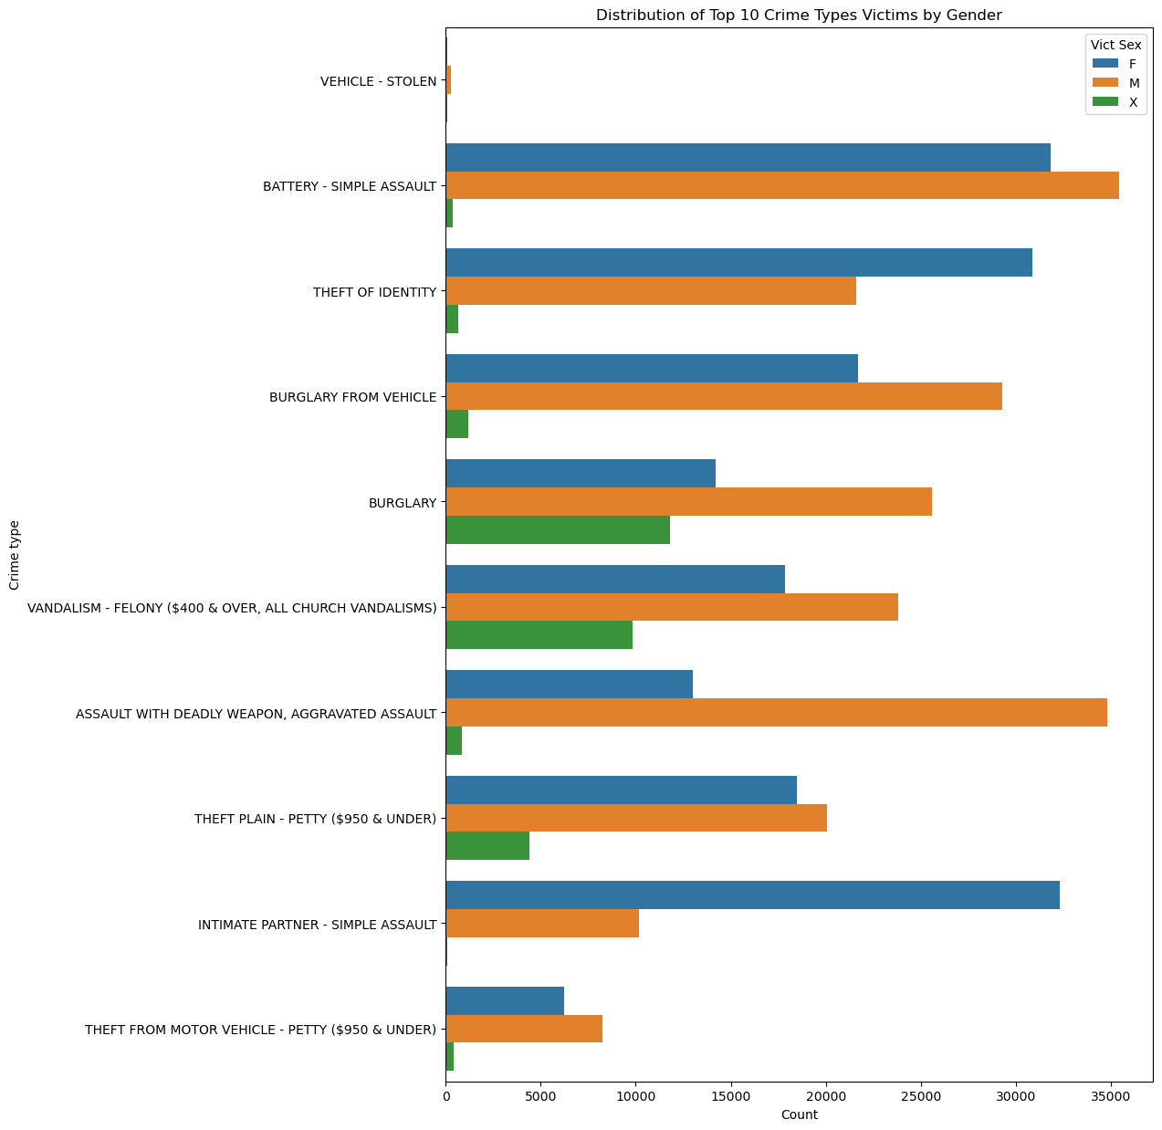
Visualization 6:
Grouped bar plot showing the Distribution of Top 10 Crime Type Victims by Gender

Slide 16
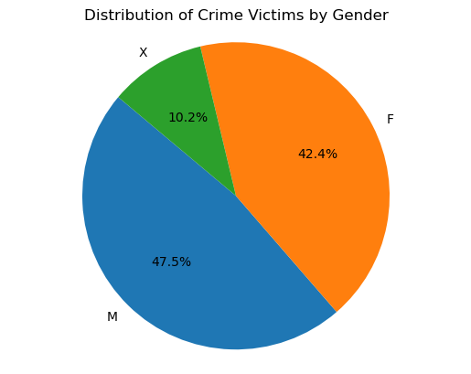
Visualization 6:
Pie chart showing the distribution of Crime Victims by Gender.

Slide 17
Distribution of Crime Type Victims by Descent
Looking at the visualizations, it's evident that the 3 ethnic groups that represent the highest percentage of crime victims by descent are Hispanic, White and Black.
Hispanic – Victims of Hispanic descent represent the highest percentage of crime victims: 35.8%.
White – White Victims represent the second highest percentage of crime victims: 23.8%.
Black – Black Victims represent the third highest percentage of crime victims: 16.6%.
Unknown – 9.3% of Victims are of unknown descent.
Since the start of the COVID-19 pandemic, there has been an increase in the number of Hispanic and Black victims has played out almost entirely among Latino and Black victims of homicides in Los (Rector, 2021, paras. 1),

Slide 18
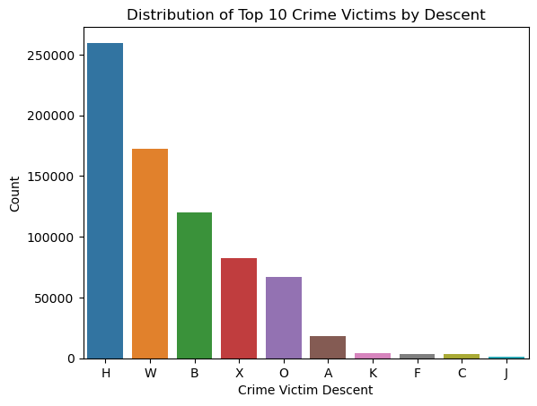
Visualization 9:
Pie chart showing the distribution of Top 10 Crime Victims by Descent.

Slide 19
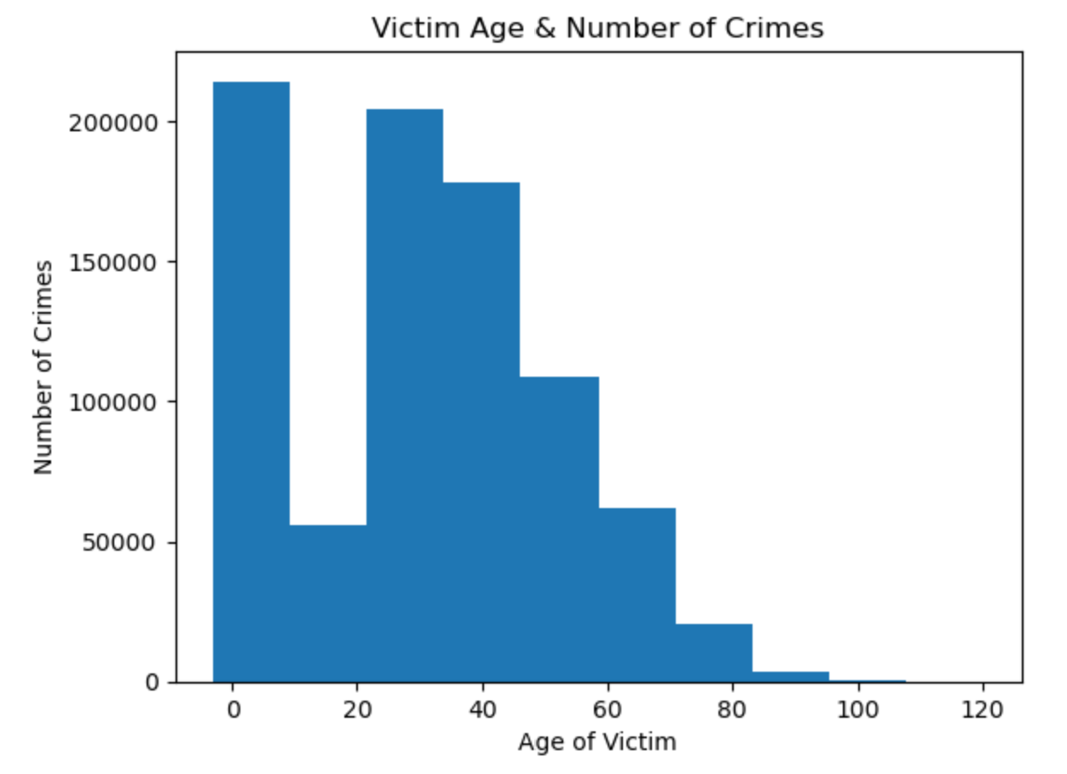
Are There Any Specific Groups of People Being Targeted? Focus: Age

Slide 20
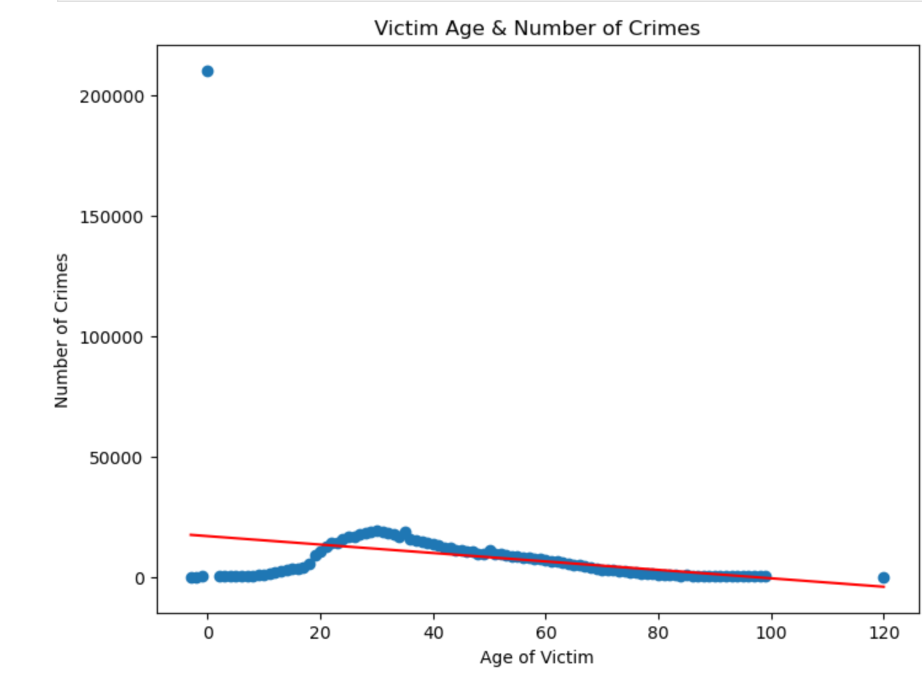
Visualization 7
Scatterplot displaying the Number of Crimes Committed Against Victims at Different Ages.

Slide 21
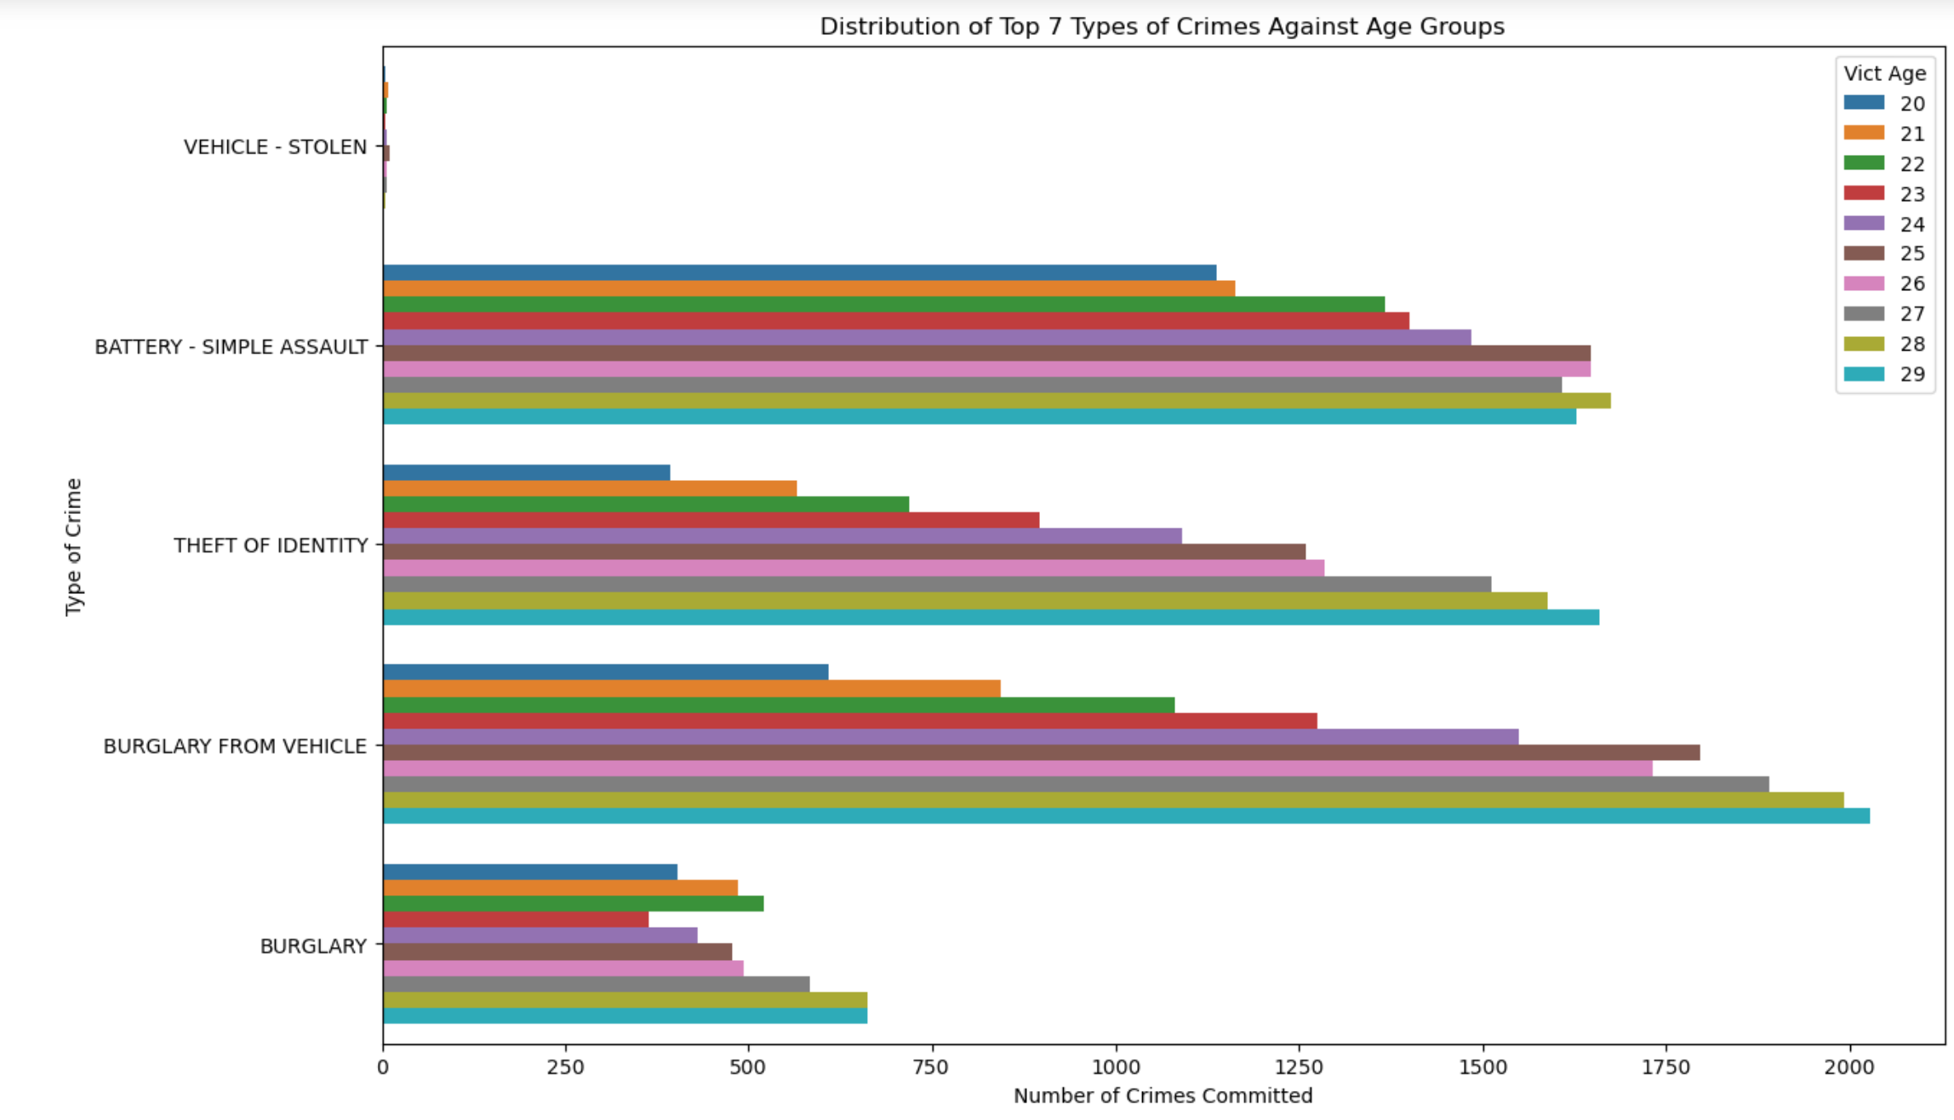
Victims at Ages 20-29

Slide 22
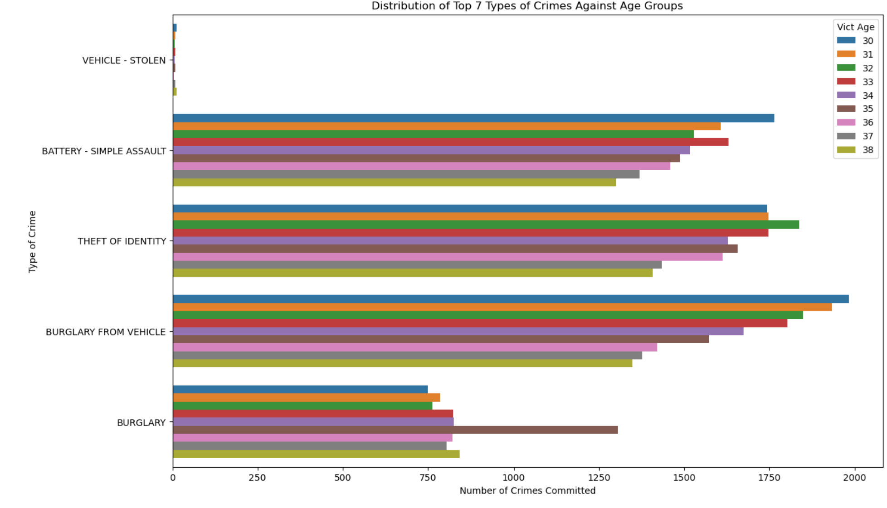
Victims At Ages 30-39

Slide 23
Conclusion
Age and Crime Relationship:
Crimes exhibit a clear age-related pattern, peaking around 30 and declining as age increases.
Peak Age Group:
The highest crime frequency occurs in the 25 to 30 age group.
Negative Trend:
A negative trend line emphasizes a consistent decrease in crimes as age advances.
Baseline and Endpoint:
The trend line starts at 15,000 crimes, showcasing a baseline, and gradually approaches zero for older age groups.
Interpretation:
The data underscores a distinct age-related trend, indicating a significant peak around 30, followed by a decline. The negative trend line suggests a diminishing victimization likelihood among older individuals, necessitating deeper analysis for a comprehensive understanding.
Additional Insights - Histogram Analysis:
The histogram delves deeper into the age distribution of crimes, revealing nuanced insights. The 25 to 30 age group stands out with the highest crime frequency, warranting focused attention for crime prevention initiatives. Notably, age groups such as 58 to 73, 73 to 78, 78 to 90, and 90 to 100 exhibit lower crime frequencies, presenting opportunities for targeted interventions in these segments. The visual representation of the histogram aids in identifying concentration and dispersion of crime occurrences across different age brackets. This expanded summary provides a more detailed exploration of the histogram analysis, emphasizing its role in uncovering age-specific crime patterns and guiding strategic preventive measures.

Slide 24
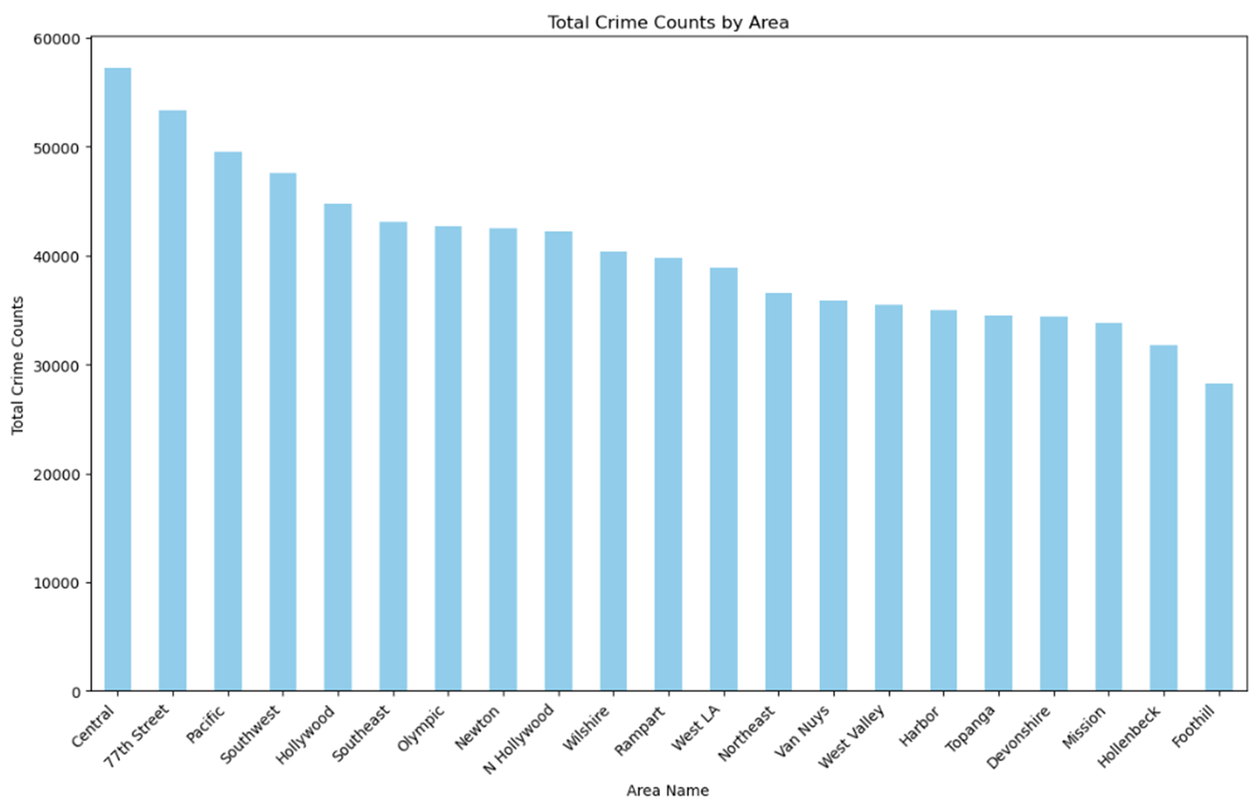
Significance of our answers:
Are the variations in the crime rate across the different areas significant?
Central and 77th are 1 and 2 for highest crime
there is not enough evidence to conclude that there exist significant differences in crime count between the 21 areas (p-value=2.53)

Slide 25
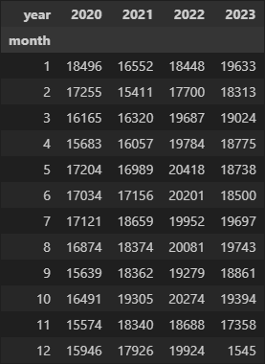
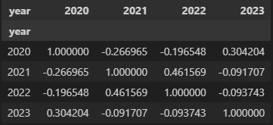
Is crime increased during certain months in a year?
there is not enough evidence to conclude that there exist significant differences in crime count between the months
Is crime consistent for each month over the years?
weak to medium correlations across the board, meaning there is no particular month thats sees a consistent trend

Slide 26
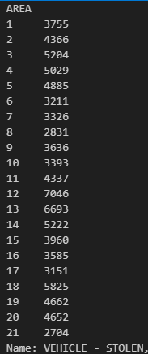
Vehicle Theft is the most common crime. Is the contribution specifically from one area?
there is not enough evidence to conclude that one area significantly contributes to vehicle theft

Slide 27

Are there any specific groups of people being targeted?
there is not enough evidence to conclude that one age group is being specifically targeted, significantly (p-value = 3.83)
Men are victims significantly more than the other (p-value = 0.003)

Slide 28
Contributions to Project Questions:
Question 1 (Crime distribution by area):
Fabia's expertise in data collection and preprocessing, combined with Raymon's prowess in data visualization, resulted in a bar plot displaying total crime counts for each area. Additionally, statistical analysis, particularly the t-test comparing crime counts between different areas, was conducted.
Question 2 (Monthly crime trends over the years):
Mike's leadership in statistical analysis and Jia's contributions to interpreting findings led to comprehensive insights into crime trends. Visualizations, such as line plots for crime trends and correlation analysis using scatter plots, were key aspects of this investigation.
Question 3 (Distribution of crime types):
Raymon's expertise in data visualization contributed to the creation of pie charts or bar plots illustrating the distribution of crime types. Statistical analysis was conducted using the chi-square test to explore associations between crime types and other categorical variables.
Question 4 (Demographics of crime victims):
Visualizations depicting demographic distributions were a result of Ariana's and Jia's contributions. Additionally, statistical tests, including t-tests, were conducted to compare different demographic groups based on victim demographics.

Slide 29
Bibliography
Crime Data from 2020 to Present (City of Los Angeles):
https://catalog.data.gov/dataset/crime-data-from-2020-to-present

